Slide 1
Mutations of one or a few nucleotides can affect protein structure and function
Mutations are changes in the genetic material of a cell or virus
Point mutations are chemical changes in just one base pair of a gene
The change of a single nucleotide in a DNA template strand can lead to the production of an abnormal protein

Slide 2
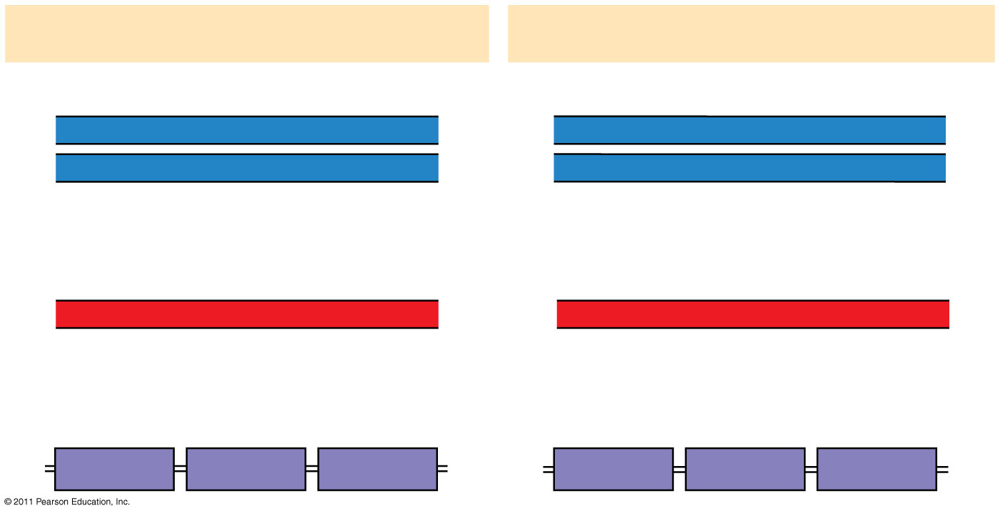
Figure 17.23
Wild-type hemoglobin
Sickle-cell hemoglobin
Wild-type hemoglobin DNA
Mutant hemoglobin DNA
3′
C
T
T
5′
3′
C
A
T
5′
5′
G
A
A
3′
5′
G
T
A
3′
mRNA
mRNA
5′
G
A
A
3′
5′
G
U
A
3′
Normal hemoglobin
Sickle-cell hemoglobin
Glu
Val
Notes:
Figure 17.23 The molecular basis of sickle-cell disease: a point mutation.

Slide 3
Point mutations within a gene can be divided into two general categories
Nucleotide-pair substitutions
One or more nucleotide-pair insertions or deletions

Slide 4
A nucleotide-pair substitution replaces one nucleotide and its partner with another pair of nucleotides
Silent mutations have no effect on the amino acid produced by a codon because of redundancy in the genetic code
Missense mutations still code for an amino acid, but not the correct amino acid
Nonsense mutations change an amino acid codon into a stop codon, nearly always leading to a nonfunctional protein

Slide 5
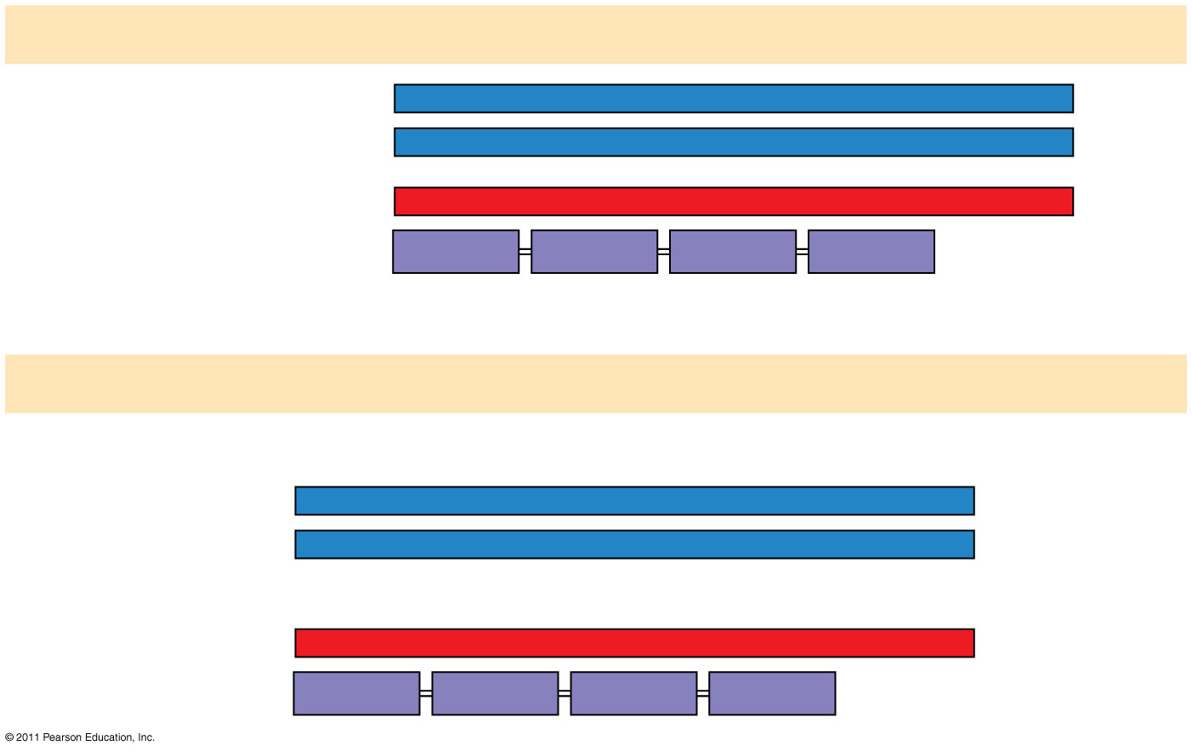
Figure 17.24a
Wild type
DNA template strand
3′
T
A
C
T
T
C
A
A
A
C
C
G
A
T
T
5′
5′
A
T
G
A
A
G
T
T
T
G
G
C
T
A
A
3′
mRNA5′
A
U
G
A
A
G
U
U
U
G
G
C
U
A
A
3′
Protein
Met
Lys
Phe
Gly
Stop
Amino end
Carboxyl end
(a) Nucleotide-pair substitution: silent
A instead of G
3′
T
A
C
T
T
C
A
A
A
C
C
A
A
T
T
5′
5′
A
T
G
A
A
G
T
T
T
G
G
T
T
A
A
3′
U instead of C
5′
A
U
G
A
A
G
U
U
U
G
G
U
U
A
A
3′
Met
Lys
Phe
Gly
Stop
Notes:
Figure 17.24 Types of small-scale mutations that affect mRNA sequence.

Slide 6
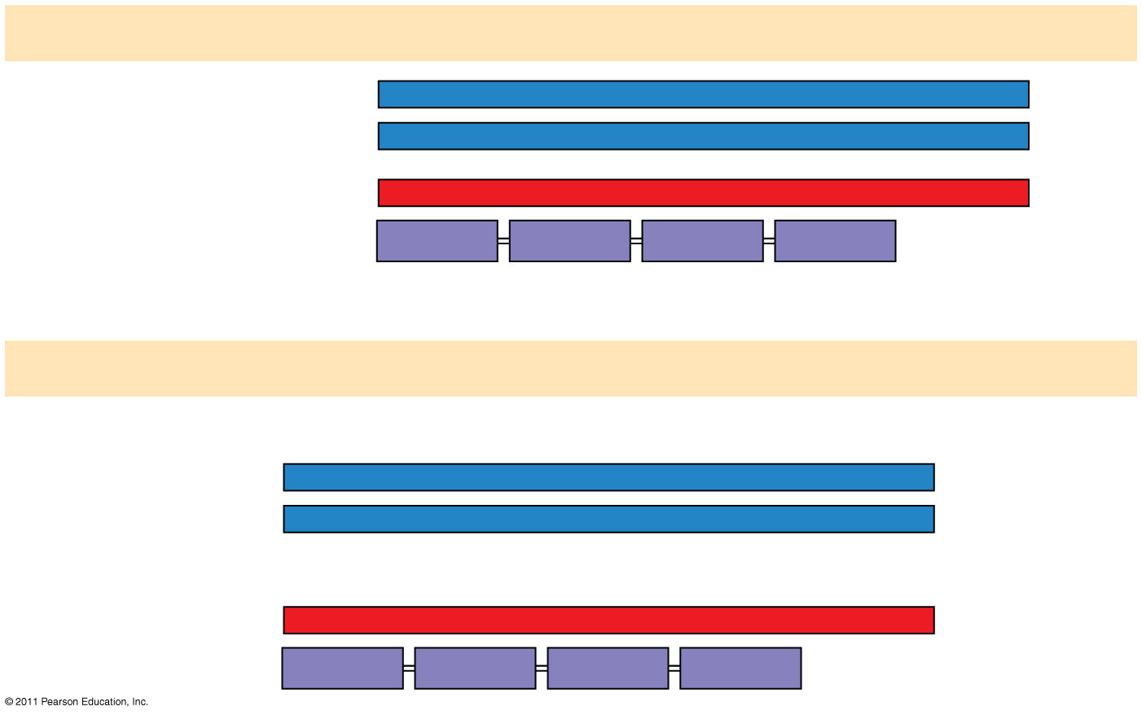
Figure 17.24b
Wild type
DNA template strand
3′
T
A
C
T
T
C
A
A
A
C
C
G
A
T
T
5′
5′
A
T
G
A
A
G
T
T
T
G
G
C
T
A
A
3′
mRNA5′
A
U
G
A
A
G
U
U
U
G
G
C
U
A
A
3′
Protein
Met
Lys
Phe
Gly
Stop
Amino end
Carboxyl end
(a) Nucleotide-pair substitution: missense
T instead of C
3′
T
A
C
T
T
C
A
A
A
T
C
G
A
T
T
5′
5′
A
T
G
A
A
G
T
T
T
A
G
C
T
A
A
3′
A instead of G
5′
A
U
G
A
A
G
U
U
U
A
G
C
U
A
A
3′
Met
Lys
Phe
Ser
Stop
Notes:
Figure 17.24 Types of small-scale mutations that affect mRNA sequence.

Slide 7
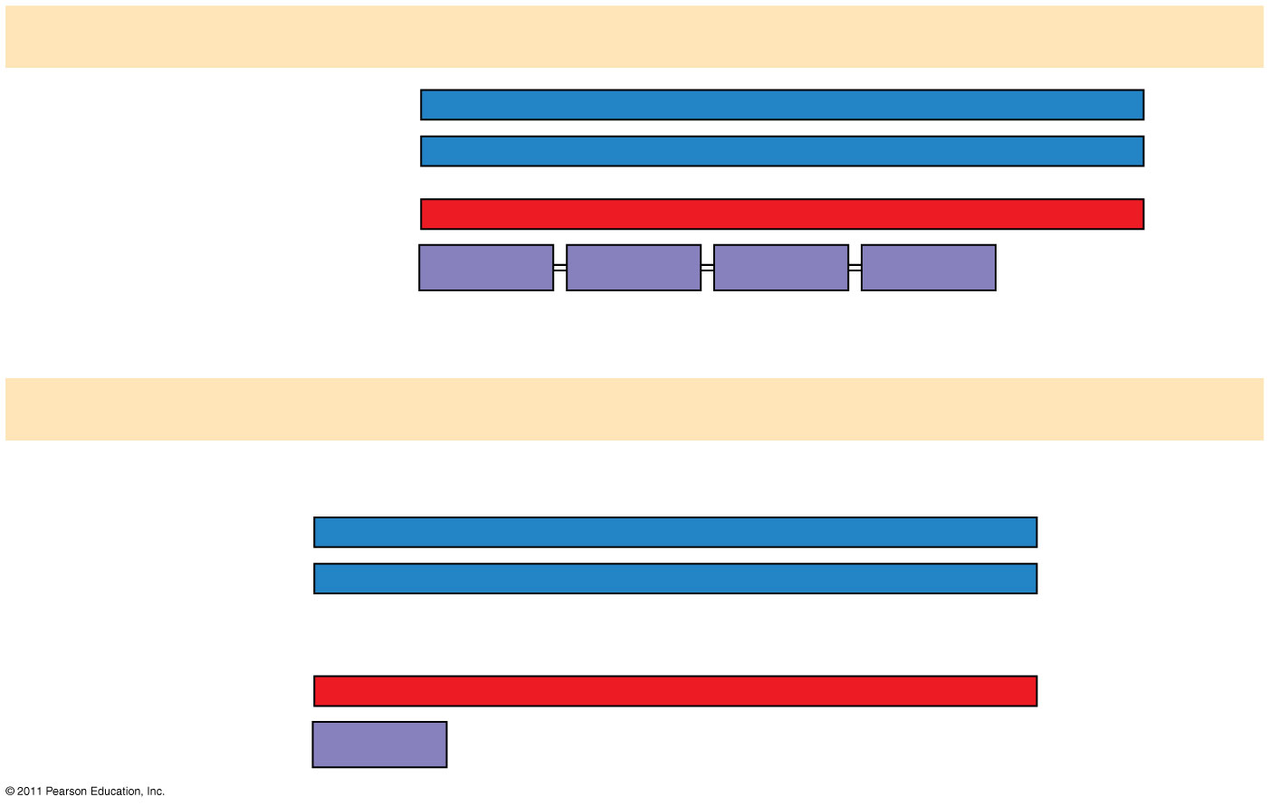
Figure 17.24c
Wild type
DNA template strand
3′
T
A
C
T
T
C
A
A
A
C
C
G
A
T
T
5′
5′
A
T
G
A
A
G
T
T
T
G
G
C
T
A
A
3′
mRNA5′
A
U
G
A
A
G
U
U
U
G
G
C
U
A
A
3′
Protein
Met
Lys
Phe
Gly
Stop
Amino end
Carboxyl end
(a) Nucleotide-pair substitution: nonsense
A instead of T
T instead of C
3′
T
A
C
A
T
C
A
A
A
C
C
G
A
T
T
5′
5′
A
T
G
T
A
G
T
T
T
G
G
C
T
A
A
3′
U instead of A
5′
A
U
G
U
A
G
U
U
U
G
G
C
U
A
A
3′
Met
Stop
Notes:
Figure 17.24 Types of small-scale mutations that affect mRNA sequence.

Slide 8
Insertions and deletions are additions or losses of nucleotide pairs in a gene
These mutations have a disastrous effect on the resulting protein more often than substitutions do
Insertion or deletion of nucleotides may alter the reading frame, producing a frameshift mutation

Slide 9
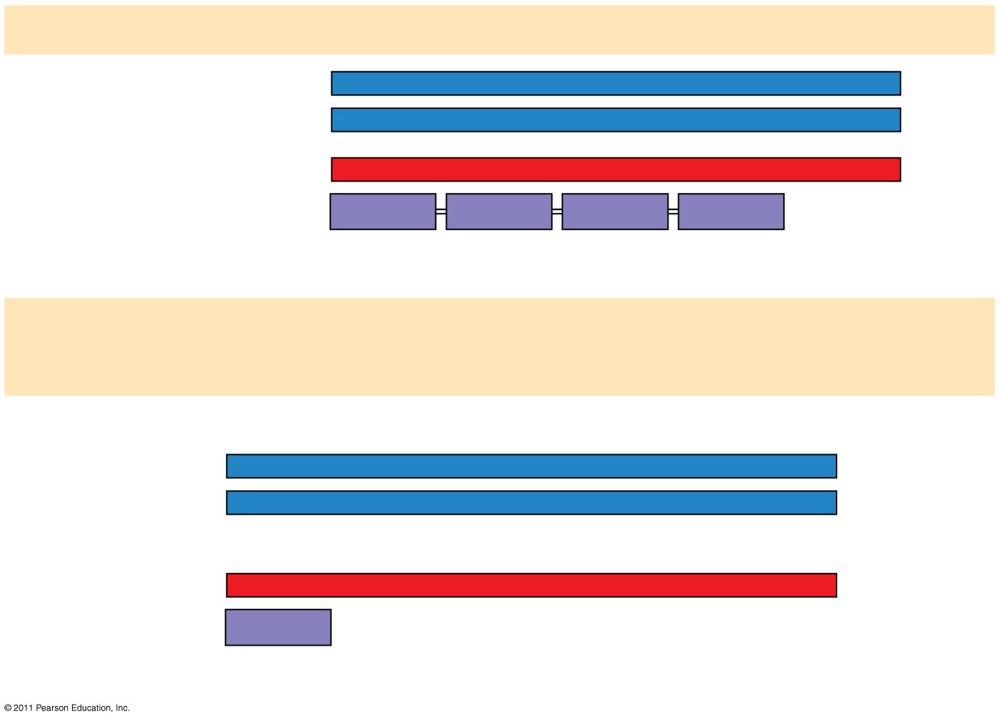
Figure 17.24d
Wild type
DNA template strand
3′
T
A
C
T
T
C
A
A
A
C
C
G
A
T
T
5′
5′
A
T
G
A
A
G
T
T
T
G
G
C
T
A
A
3′
mRNA5′
A
U
G
A
A
G
U
U
U
G
G
C
U
A
A
3′
Protein
Met
Lys
Phe
Gly
Stop
Amino end
Carboxyl end
(b) Nucleotide-pair insertion or deletion: frameshift causing
immediate nonsense
Extra A
3′
T
A
C
A
T
T
C
A
A
A
C
G
G
A
T
T
5′
5′
A
T
G
T
A
A
G
T
T
T
G
G
C
T
A
A
3′
Extra U
5′
A
U
G
U
A
A
G
U
U
U
G
G
C
U
A
A
3′
Met
Stop
1 nucleotide-pair insertion
Notes:
Figure 17.24 Types of small-scale mutations that affect mRNA sequence.

Slide 10
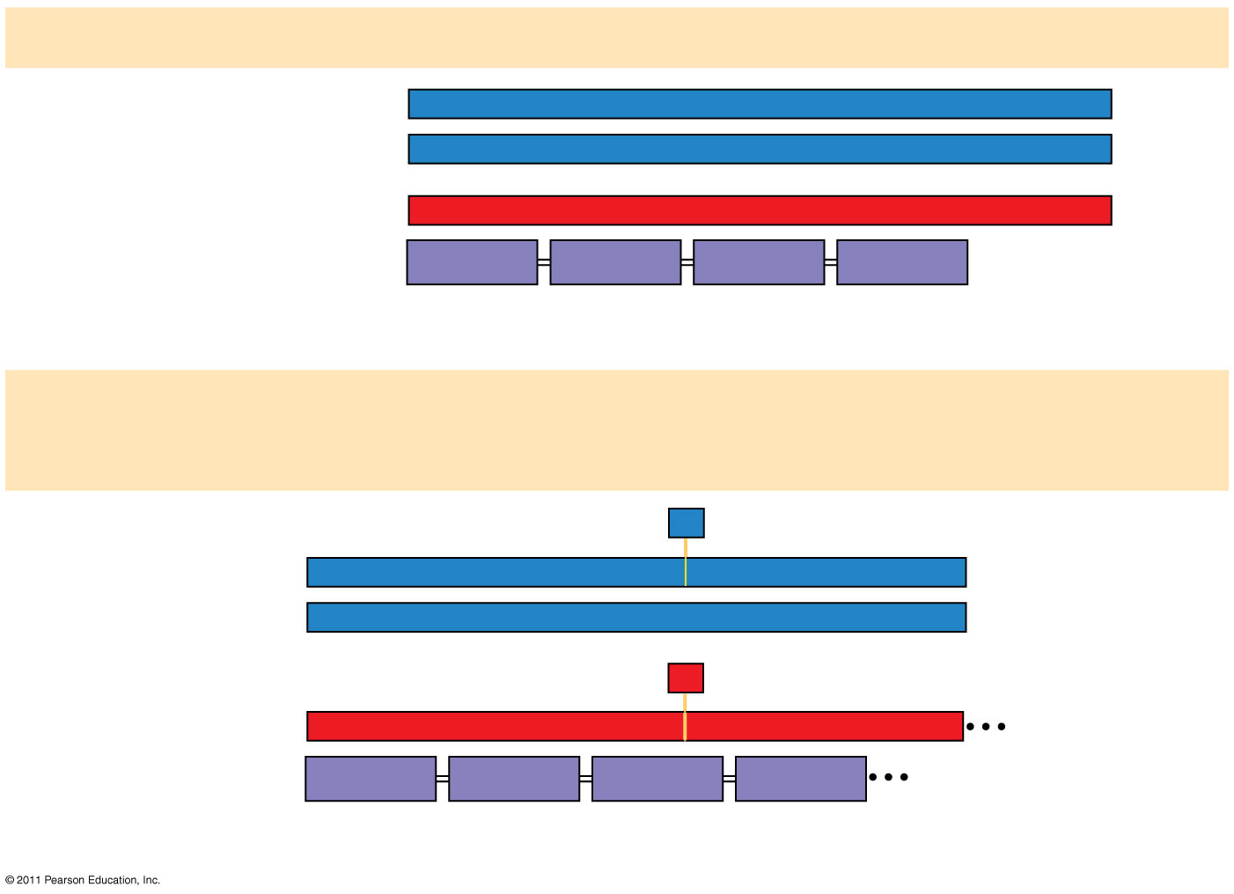
Figure 17.24e
Wild type
DNA template strand
3′
T
A
C
T
T
C
A
A
A
C
C
G
A
T
T
5′
5′
A
T
G
A
A
G
T
T
T
G
G
C
T
A
A
3′
mRNA5′
A
U
G
A
A
G
U
U
U
G
G
C
U
A
A
3′
Protein
Met
Lys
Phe
Gly
Stop
Amino end
Carboxyl end
(b) Nucleotide-pair insertion or deletion: frameshift causing
extensive missense
A
missing
3′
T
A
C
T
T
C
A
A
C
C
G
A
T
T
5′
5′
A
T
G
A
A
G
T
T
G
G
C
T
A
A
3′
U
missing
5′
A
U
G
A
A
G
U
U
G
G
C
U
A
A
3′
Met
Lys
Leu
Ala
1 nucleotide-pair deletion
Notes:
Figure 17.24 Types of small-scale mutations that affect mRNA sequence.

Slide 11
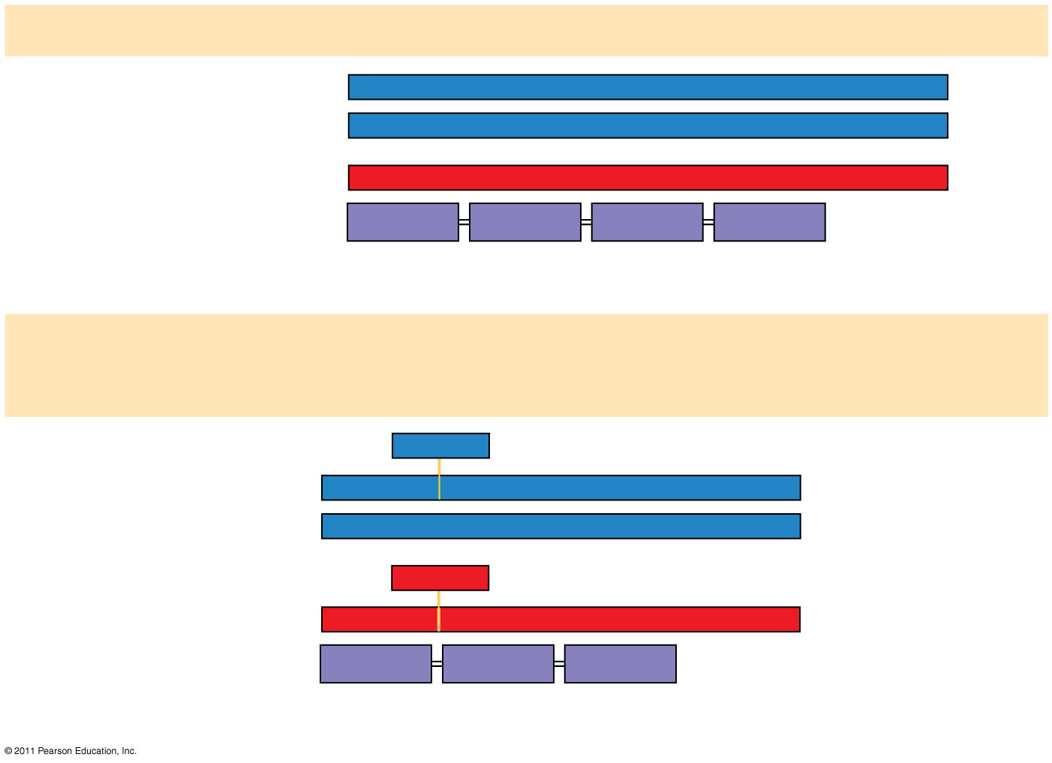
Figure 17.24f
Wild type
DNA template strand
3′
T
A
C
T
T
C
A
A
A
C
C
G
A
T
T
5′
5′
A
T
G
A
A
G
T
T
T
G
G
C
T
A
A
3′
mRNA5′
A
U
G
A
A
G
U
U
U
G
G
C
U
A
A
3′
Protein
Met
Lys
Phe
Gly
Stop
Amino end
Carboxyl end
(b) Nucleotide-pair insertion or deletion: no frameshift, but one
amino acid missing
T
T
C
missing
3′
T
A
C
A
A
A
C
C
G
A
T
T
5′
5′
A
T
G
T
T
T
G
G
C
T
A
A
3′
A
A
G
missing
5′
A
U
G
U
U
U
G
G
C
U
A
A
3′
Met
Phe
Gly
Stop
3 nucleotide-pair deletion
Notes:
Figure 17.24 Types of small-scale mutations that affect mRNA sequence.

Slide 12
Mutagens
Spontaneous mutations can occur during DNA replication, recombination, or repair
Mutagens are physical or chemical agents that can cause mutations

Slide 13
Comparing Gene Expression in Bacteria, Archaea, and Eukarya
Bacteria and eukarya differ in their RNA polymerases, termination of transcription, and ribosomes; archaea tend to resemble eukarya in these respects
Bacteria can simultaneously transcribe and translate the same gene
In eukarya, transcription and translation are separated by the nuclear envelope
In archaea, transcription and translation are likely coupled

Slide 14
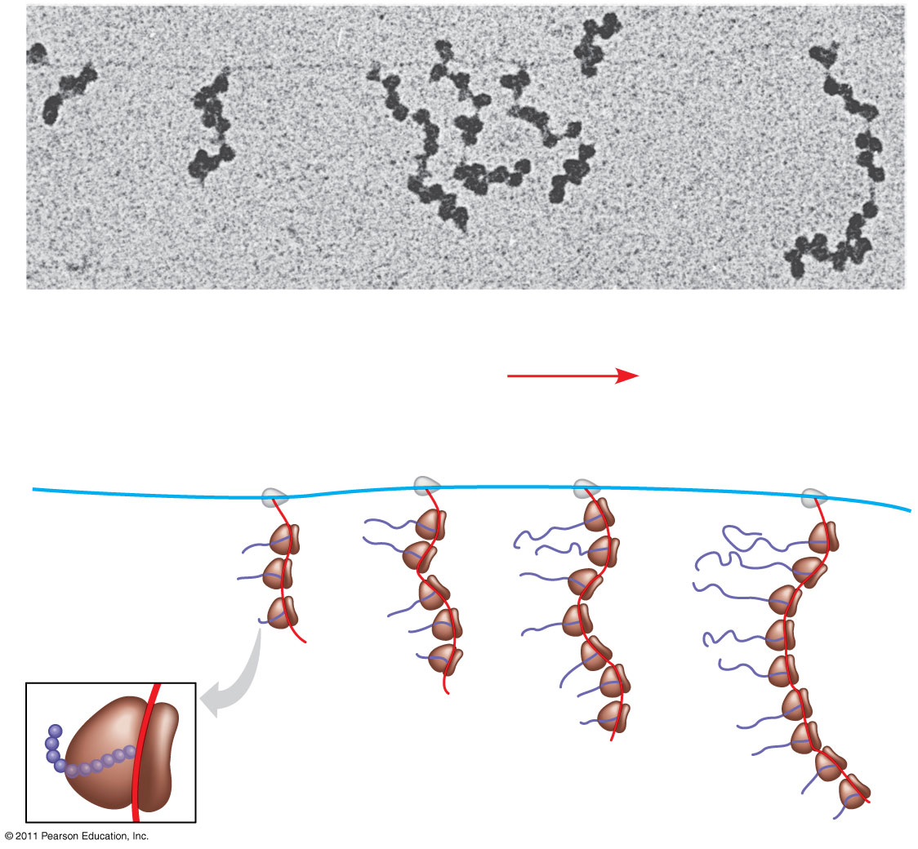
Figure 17.25
RNA polymerase
DNA
mRNA
Polyribosome
Direction of transcription
0.25 μm
RNA polymerase
DNA
Polyribosome
Polypeptide (amino end)
Ribosome
mRNA
(5′ end)
Notes:
Figure 17.25 Coupled transcription and translation in bacteria.

Slide 15
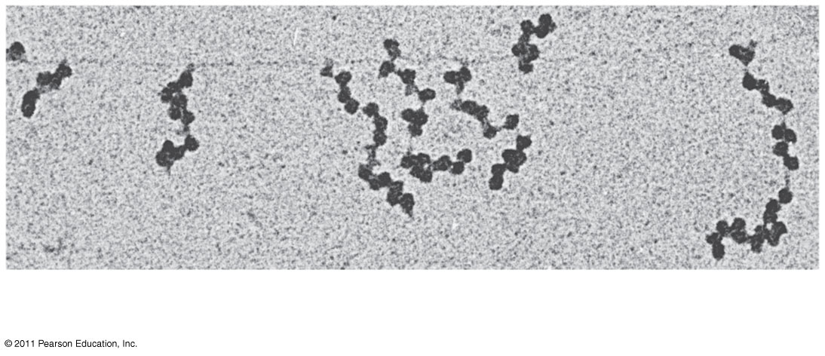
Figure 17.25a
RNA polymerase
DNA
mRNA
Polyribosome
0.25 μm
Notes:
Figure 17.25 Coupled transcription and translation in bacteria.

Slide 16
What Is a Gene? Revisiting the Question
The idea of the gene has evolved through the history of genetics
We have considered a gene as
A discrete unit of inheritance
A region of specific nucleotide sequence in a chromosome
A DNA sequence that codes for a specific polypeptide chain

Slide 17
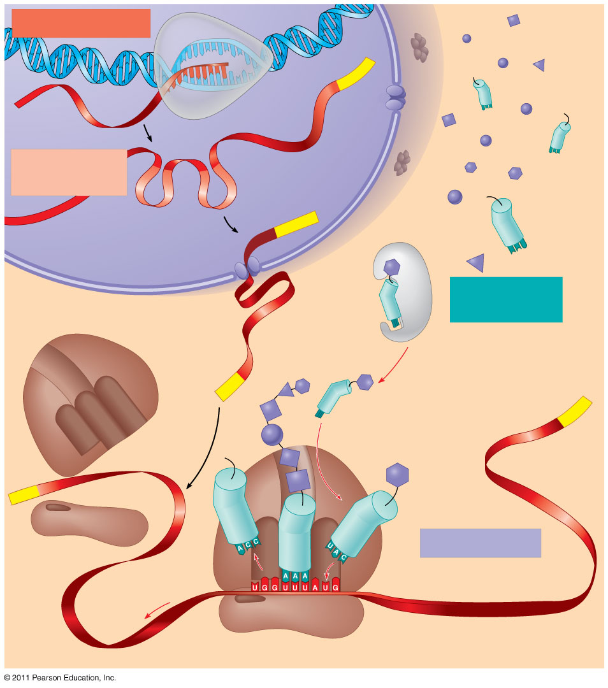
Figure 17.26
TRANSCRIPTION
DNA
3′
Poly-A
RNA
5′
RNA
polymerase
transcript
Exon
RNA
RNA transcript
PROCESSING
(pre-mRNA)
Intron
Aminoacyl-
Poly-A
tRNA synthetase
NUCLEUS
Amino acid
tRNA
AMINO ACID
CYTOPLASM
ACTIVATION
mRNA
Growing polypeptide
5′ Cap
3′
A
Aminoacyl (charged) tRNA
Poly-A
P
E
Ribosomal
subunits
5′ Cap
TRANSLATION
E
A
Anticodon
Codon
Ribosome
Notes:
Figure 17.26 A summary of transcription and translation in a eukaryotic cell.

Slide 18
In summary, a gene can be defined as a region of DNA that can be expressed to produce a final functional product, either a polypeptide or an RNA molecule

Slide 19
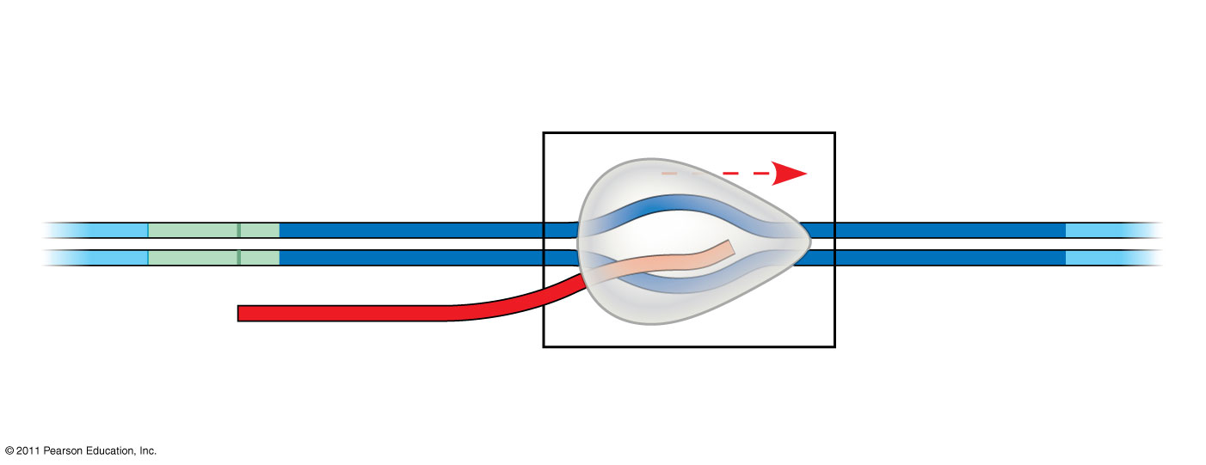
Figure 17.UN02
Transcription unit
Promoter
5′
3′
3′
3′
5′
5′
Template strand of DNA
RNA polymerase
RNA transcript
Notes:
Figure 17.UN02 Summary figure, Concept 17.2

Slide 20
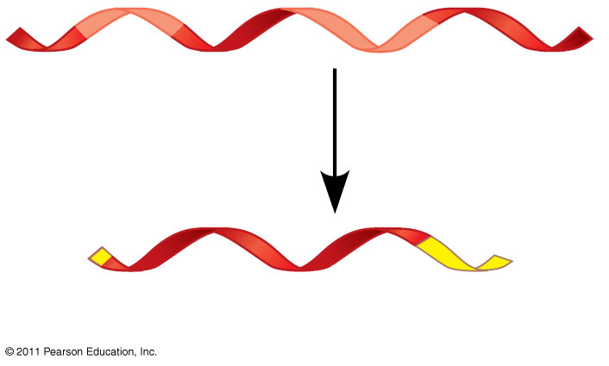
Figure 17.UN03
Pre-mRNA
5′ Cap
Poly-A tail
mRNA
Notes:
Figure 17.UN03 Summary figure, Concept 17.3

Slide 21
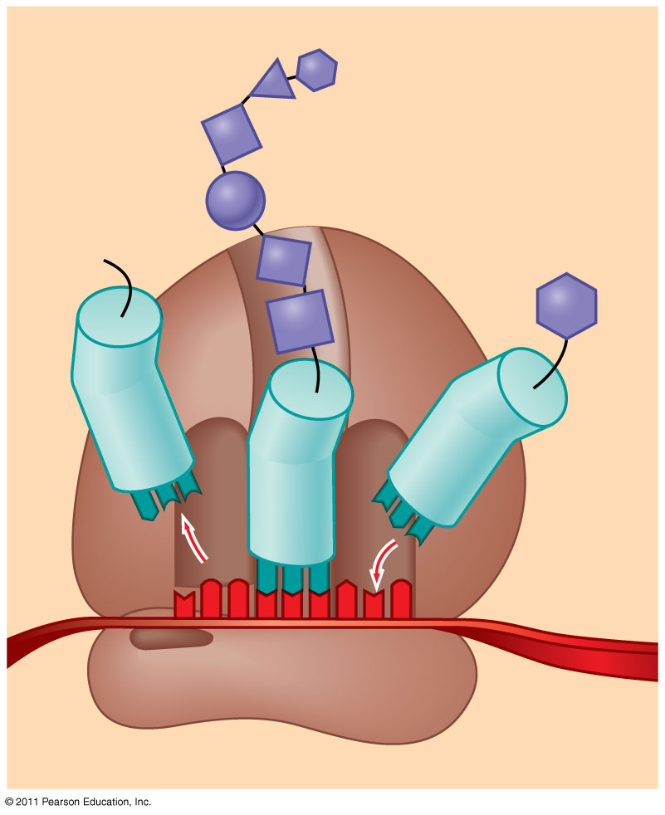
Figure 17.UN04
Polypeptide
tRNA
Amino acid
E
A
Anti- codon
Codon
mRNA
Ribosome
Notes:
Figure 17.UN04 Summary figure, Concept 17.4

